Slide 1
V.Dozortsev, L.Sorkin
June 19, 2017
‘CONNECTED’ solutions in HONEYWELL strategy
Honeywell Internal

Slide 2
Global Diversified Installed Base
+150M Homes
+10M Buildings
+10K Plants
Connected Homes
Connected Buildings
Connected Plants
Comfort
Convenience
Security
Energy Efficiency
Safety & Security
Comfort
Production Efficiency
Process Reliability
Reduced Downtime
+130K Aircrafts
Connected Aircrafts
+100M Vehicles
Connected Vehicles
+10K Warehouses
Connected Warehouses
Fuel Efficiency
Enhanced Safety
Passenger Delight
Vehicle Health
Passenger Safety
Fuel Efficiency
Improved Productivity
Worker Safety
Asset Maintenance
3.8M Customers
11K+ Developers
Well Positioned To Leverage Diversified Install Base
Honeywell Internal

Slide 3
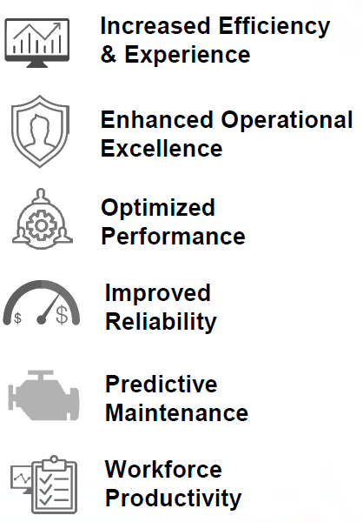
Honeywell IIoT Strategy
Strategy
Customer Values
Based on Our Industry Expertise
Industry specific value propositions
Years of end user iterations
Market presence in high barrier to entry industries
HON as Differentiator
Value through Honeywell intellectual property
Focus on industries we understand
Successful, dedicated experience team
Deliver New Offerings through new business models
Outcome based services through SaaS
PaaS opportunities through ecosystem play
Cross business synergy opportunities
Leverage Installed Base To Deliver New IIoT Offerings & Business Models
Honeywell Internal

Slide 4
Honeywell SentienceTM - Platform for all IIoT Offerings
What is Sentience?
Single Platform That All Honeywell Businesses Are Using To Build Software
Device & Data Management
From Edge to Cloud
Analytical Tools
To Quickly Turn Data Into Insights
Developer Tools
And Partner Applications
Key Performance Indicators
Speed
Eliminates Duplication
Enables Code Reuse
Delivers New Solutions Faster
Economies
Shifts Focus to Differentiation
Reduces Development Costs
Fastens Time To Sales
Scale
Supports Petabytes Of Data
Supports Billions Of Devices
Supports Gbps ingestion & access
Consumption
Standardizes through APIs
Enables Partner Eco-System
Enables Cross-Connected Offerings
SentienceTM Enables HON Businesses To Deliver New IIoT Offerings
Honeywell Internal

Slide 5

Honeywell strategic vision of Industry 4.0 trends
Smart Operations
Digital Transformation
CPS (Connected Performance Services)
“Integrated Suites” and programmatic delivery methodology to solve real customer challenges at the Enterprise level.
Bring IIoT innovation to Solutions with connectivity, analytics, cloud, & mobility, for new level of services and adopt new business models
Around-the-clock monitoring of plant data and rigorous simulations to analyze plant performance to reveal full potential through a cloud-based service.
Enabled by Analytics, Mobility, Cloud, OEM Partners, Connectivity Delivered on AS proven Software
Drive a software culture leveraging Honeywell unique capabilities, technologies, and domain knowledge
Innovation aligned to emerging industry trends and customer initiatives
Notes:
1.SO - Навести порядок на самом предприятии, устранить разрывы в автоматизации.
Необходимо использовать программный подход – синхронизация проектов в рамках программы.
Мотивация Заказчика достижение бизнес целей, которые контролируются руководством.
2.DT – переход к интернет технологиям, изменение бизнес-процессовс помощью автоматизации.
Получается SO через DT.
3.Получается CPS, аналогично, для достижения целей SO.
CPS обеспечивают дополнительные возможности, когда внутренняя экспертиза уже исчерпана.
Предполагается развитие услуги CPS не только для UOP, но и для других вендоров.
При этом, в основе достижения всех целей лежат идеи AS.

Slide 6







Enterprise Intelligence: Connect process intelligence to business KPIs across entire enterprise
How Does IIoT Work?
Apply powerful analytics to detect and predict issues
Organize and visualize data in asset context
Process
Reliability
Production
Efficiency
Supply Chain Optimization
ACTIONS
ACTIONS
ACTIONS
Capture real-time process and event data
Physical and Cyber Security

Slide 7
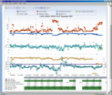



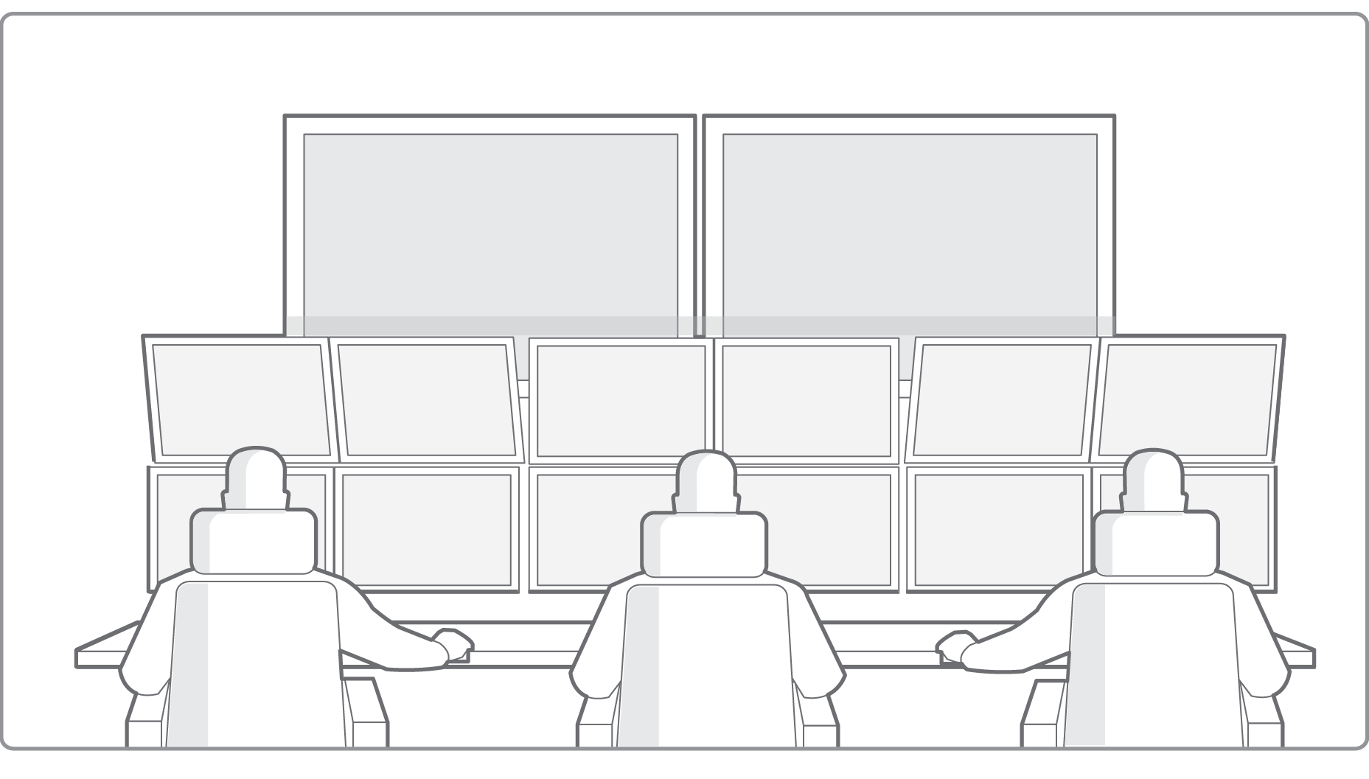

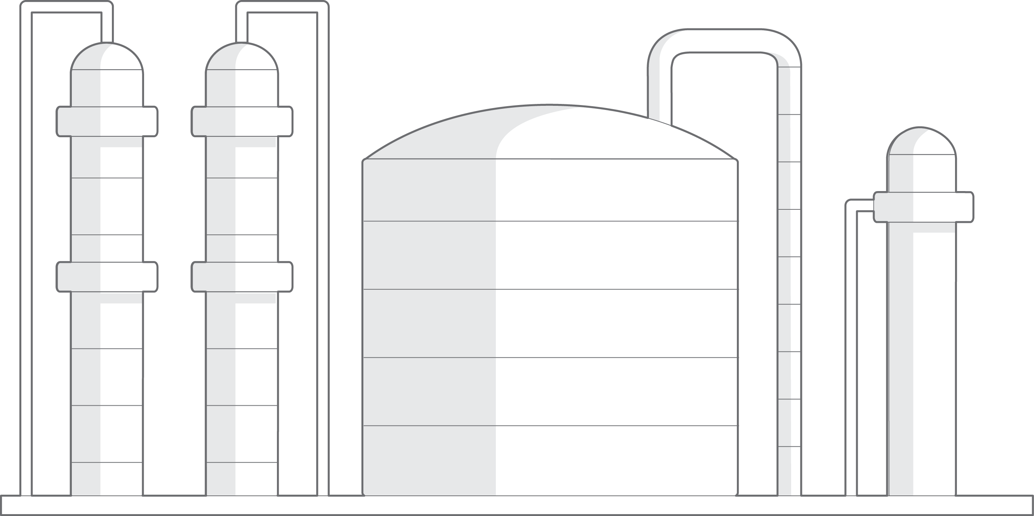

Connected Performance Services
Enterprise Intelligence: Applying powerful analytics for early detection and forecast of failure and to optimize process modes
Cloud Based
Multi-Asset Model “Digital Twin”
High Speed
Single Asset Model
2
Customer SME
1
Customer Site
SECURED
DATA
Iterative
Optimization
200 embedded
KPI
3
Expert Support
4
Site Operations
Actions
Insights & Recommendations
Optimize process yields
Maximize mix of feeds to convert
Lower energy utilization
Extend useful catalyst lifetime
Benchmark site-to-site operations
Notes:
Customer is able to maximize plant performance by:
Optimizing process yields
Maximizing mix of feeds to convert
Lowering energy utilization
Extending useful catalyst lifetime
Benchmarking site-to-site operations

Slide 8
Economic Benefits at UOP Oleflex process
Typical benefits
What
How
Operations excellence
Performance improvements due to better understanding of key process parameters and constraints of Oleflex plant
$ 3,4 mln/annum
Prompt response
Avoid shutdowns and early corrective actions due to faster recognition of process issues and equipment failures
Knowledge Transfer
Ensuring Knowledge refresh and situation awareness due to on-line access to critical actual information
Based on:
C3 plant capacity 510 kt/annum, price per ton $300
Does not taken into account 8-days shutdown

Slide 9




THE POWER OF CONNECTED AIRCRAFT
A connected aircraft can receive, transmit, analyze and share data enabling more informed decision-making, operational cost reduction, and an improved flying experience.
A connected aircraft anticipates opportunities and offers unique insights by harnessing the power of analytics with the confidence of a secure communication link to and from the aircraft.
Notes:
Leveraging new technology and much more reliable high-speed Wi-Fi connections, the Connected Aircraft connects an airplane’s components and equipment, enabling each to immediately send, receive and analyze data.
The Connected Aircraft revolutionizes modern-day flying, dramatically improving fleet management, flight safety, passenger experience, maintenance, flight operations, aircraft turnaround time and costs.
Using big data, analytics, and secure communications technology, we are now better able to anticipate opportunities – to avoid weather, to avoid disruption, to avoid cost, to drive faster turnaround times.

Slide 10

The marketplace for Connected aircraft
Worldwide flight delays cost airlines $25 Billion.
A grounded commercial passenger jet while being worked on can cost up to $10,000/an hour.
A single twin-engine aircraft can generate up to 844 TB of data from 12 hours of flight, which is approximately 27,000 32GB iPhone 7s.
An Airbus A380 is fitted with as many as 25,000 sensors.
“How climate change could mean more jet turbulence”
USA Today
“Internet Of Things Can Be Beneficial To Airline MROs
Aviation Week
“American Airlines Sues Gogo Over God-Awful Inflight Wi-Fi”
Wired
“The EU tackles growing aviation emissions”
European Commission
Notes:
With the proliferation of satellite communications, and the transformation of planes from analog vehicles into digital nodes in the sky, planes are generating more data now than ever.
This incredible amount of data has the potential to address some of the industry’s most challenging issues: fuel efficiency and environmental impact; aircraft availability, passenger demand for connectivity, cost efficiency and more.

Slide 11
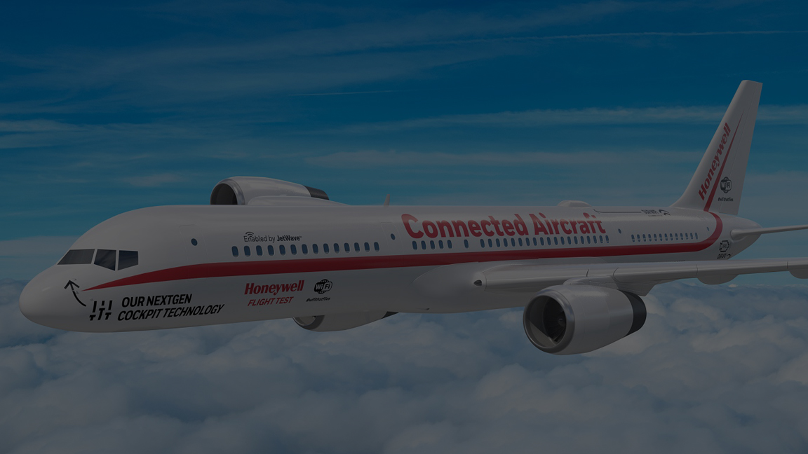




The BENEFITS OF CONNECTED Aircraft
Fleet Management
Reduces fuel costs and emissions up to 5%
Reduces operational disruptions by up to 35%
Cut down Inoperative Equipment by up to 86%
Passenger Experience
Provides 10-100X faster Wi-Fi speeds
Offers high speed connection with fewer drops
Facilitates smoother and safer flights
Flight Operations
Cuts the cost of network disruption
Saves up to 5% in flight time with ATC priority
Improves arrival times and dispatch speed
Ground Operations
Reduces “grounded” time
Avoids costly hazards
Cuts troubleshooting time by up to 25%
Notes:
These are just some examples of the benefits that connectivity can bring.
Each of the examples are real – Honeywell has been able to demonstrate these benefits with our current connected offerings.
For example, Honeywell’s GoDirect Fuel Efficiency software collects data from airline IT systems to provide data analysis and reporting which can optimize fuel usage with as much as 5 percent annual fuel savings, and drive reduced emissions.
For example, GoDirect Weather Information Service may save airlines from $25,000 to $100,000 per aircraft annually through avoiding hazardous conditions, reducing delays and diversions, lowering anti-ice usage, and decreasing maintenance costs and downtime.
For example, Honeywell’s JetWave hardware which enables GX Aviation is the first truly global broadband high-speed network. It is up to 100 times faster than other global satellite networks available today.
With data analytics and our Sentience platform, the opportunities go well beyond just these examples – we can work with you to review your own operations to see what is possible.

Slide 12

The STAKEHOLDERS OF CONNECTED AIRCRAFT
“If I can visualize the landing at a difficult airport, I can ensure a smooth landing for my passengers.”
“If I knew what parts of the aircraft needed repair before the flight arrived, I could turn the aircraft around faster.”
Pilot
Maintainer
“Why shouldn’t I get the same Wi-Fi speeds in-flight as I do at home?”
“If I could see what weather the pilots are dealing with, I could better re-route the fleet.”
Passenger
Flight Ops Manager
CEO/CFO
“If my team could better utilize the data coming on and off the aircraft, I could avoid disruptions for my operations and save costs.”
Notes:
The Connected Aircraft affects key stakeholders in the ecosystem. It can:
Delivers safer, faster and more comfortable flights for passengers
Provides real-time information for pilots and flight crews to enhance safety and efficiency.
Reduces workload for maintainers to turn around an aircraft more quickly
Helps flight operations personnel to better manage the fleet
And reduces costs and increases ease of ownership for airlines executives

Slide 13


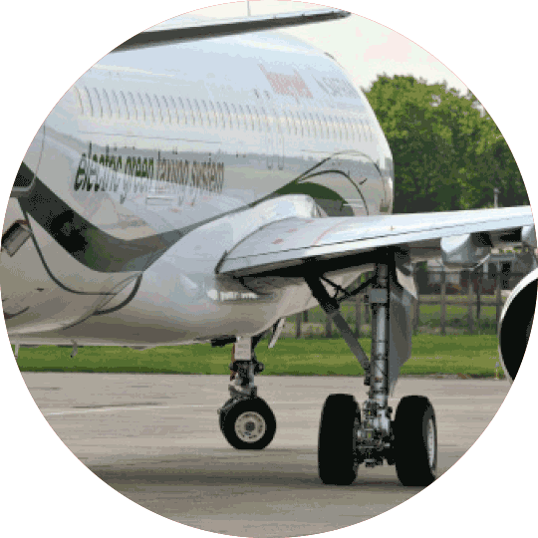

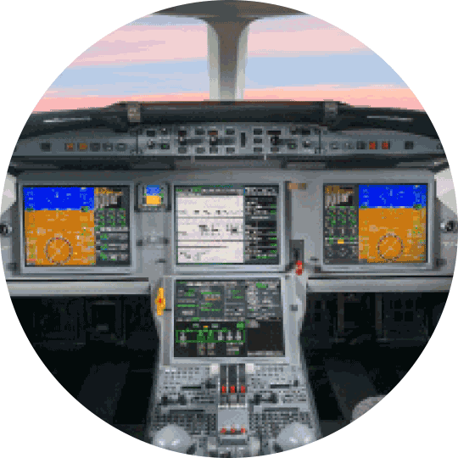

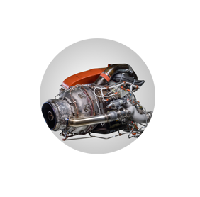
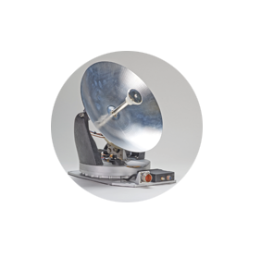

Honeywell and the CONNECTED AIRCRAFT
TO CONNECT IT, YOU NEED TO KNOW IT
130+ YEARS OF PROVEN AVIATION EXPERTISE, INNOVATION, MAINTENANCE
Install Base
Partners
25K
Engines
20K
Wheels & Brakes
First Global High-Speed Broadband Network.
20K
Flight Management
Systems
300
Services &
Apps
Pole to Pole Reliable Coverage
30K
APUs
10K
Satcom Hardware
SECURE SENTIENCE™ DATA PLATFORM.
10,000 INSTALLED SATCOM TERMINALS.
WE PROVIDE WIFI.

Slide 14



What Is A Smart Connected Building?
Green Economic and environmental benefits.
Achieves sustainable energy efficiency throughout its lifetime.
Productive Major trends: connecitivity and big data.
Provides the highest-possible level of asset utilization.
Safe The value of human life and property is critical and should be given the highest priority in any building

Slide 15
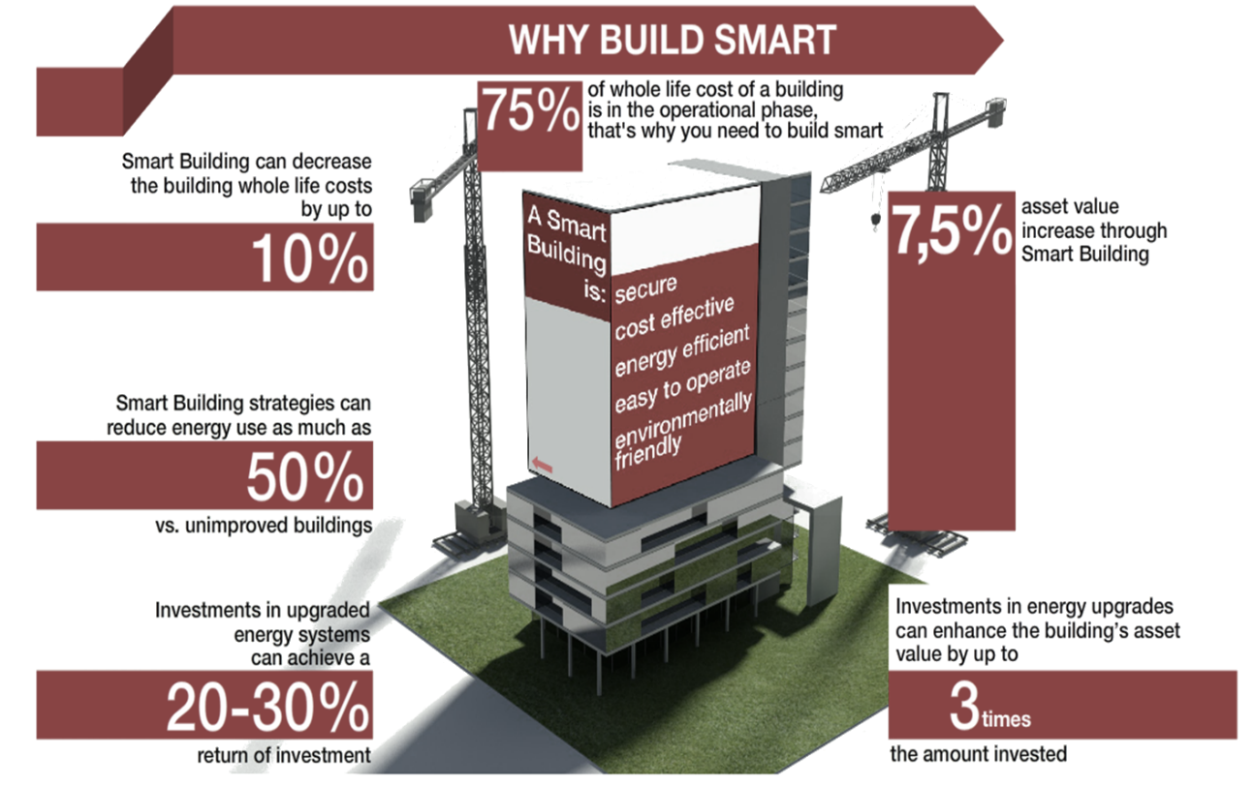
Why a Connected Building?
*McGraw Hill Institute

Slide 16

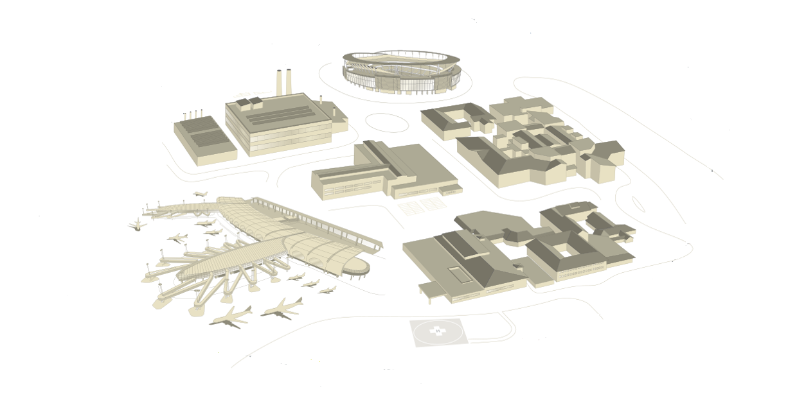













Connectivity For Buildings & People

Slide 17
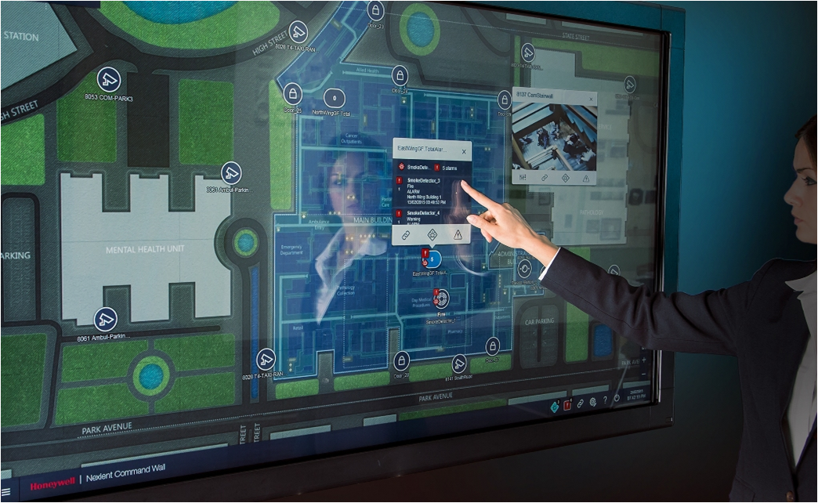
Advanced Command & Control interface

Slide 18
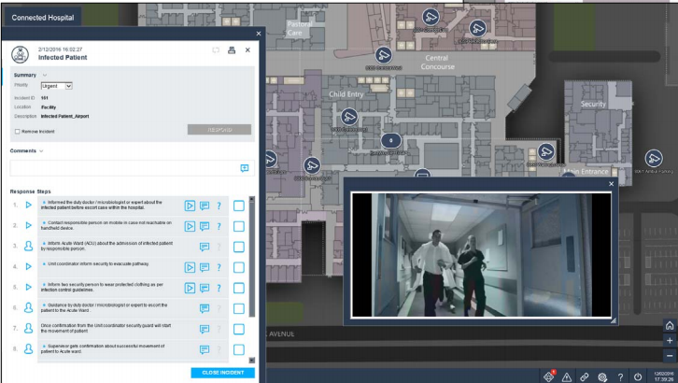
Incident Management & Traceability

Slide 19
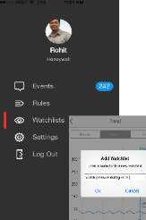
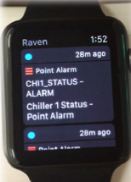
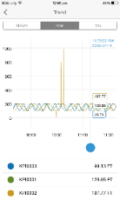



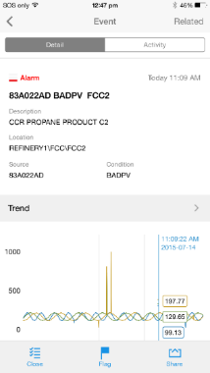
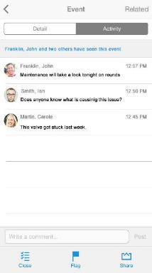


Stay Connected at all times
Real-time diagnostics and trouble-shooting
True mobility
Increased Safety
Keep an eye on it.
Dig deeper.
Real-time information
Collaboration
Act Immediately
Something happened!
What happened?
Get help.

Slide 20
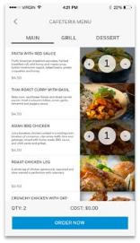

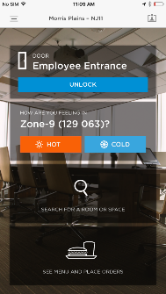
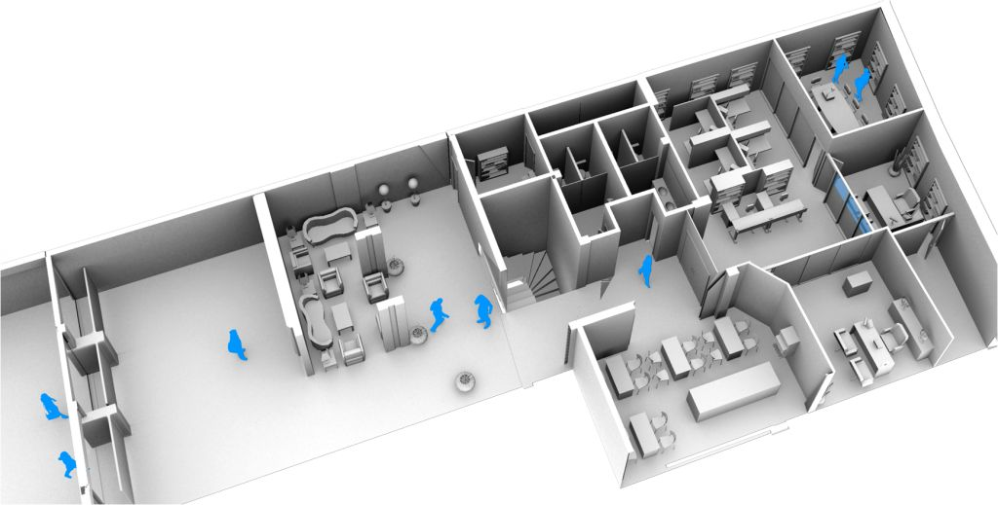
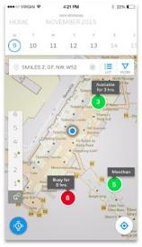
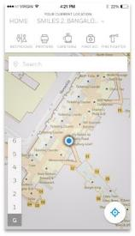

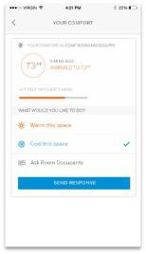

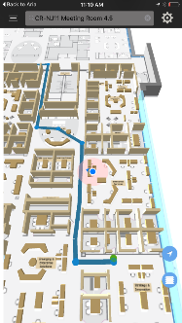
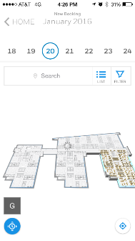
Connecting People
Comfort
Controls
Food
Ordering
Conference
Room Booking
Indoor Navigation
Unobtrusive
Access

Slide 21
V.Dozortsev, L.Sorkin
‘CONNECTED’ solutions in HONEYWELL strategy
Thank you for the attention!

